Slide 1
Research Methods
Image Recognition: Adversarial Examples in Deep Learning
R. Possas
CTDS – DS/Informatics Hub

Slide 2
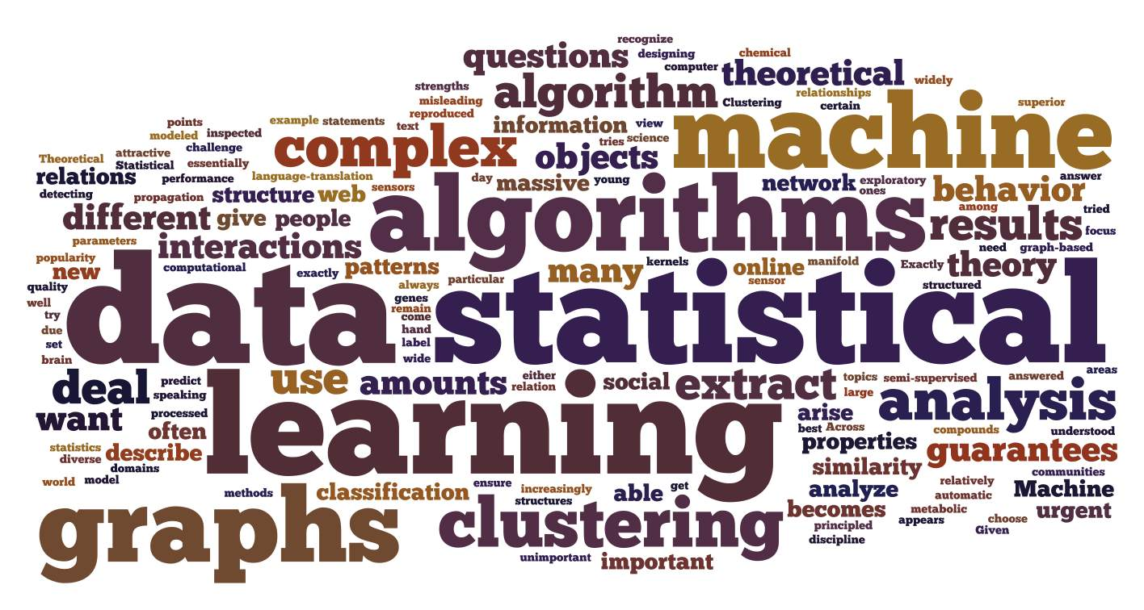
Context
Smartphones and Computers have become increasingly powerful
Cameras sensors are ubiquitous
Machine Learning algorithms are able to run on portable devices
Data is growing exponentially

Slide 3
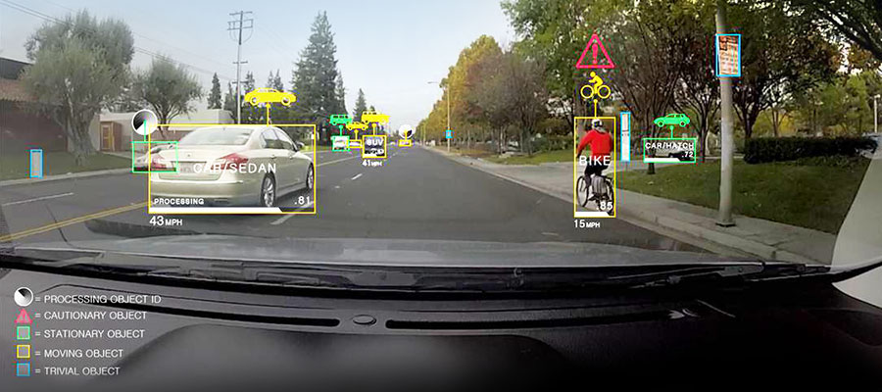
Introduction
What is Computer Vision?
“ Computer vision is an interdisciplinary field that deals with how computers can be made to gain high-level understanding from digital images or videos” - Wikipedia

Slide 4
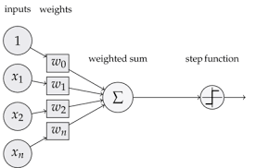
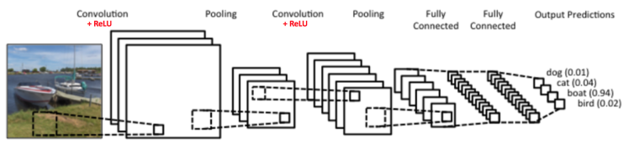
The Evolution of Neural Networks
Networks evolved from single perceptron to multi-layered networks (Convolutional Neural Nets)
Cloud Computing along with GPU power made it feasible to train complex algorithms
Highly-non linear models capable of generalizing well

Slide 5
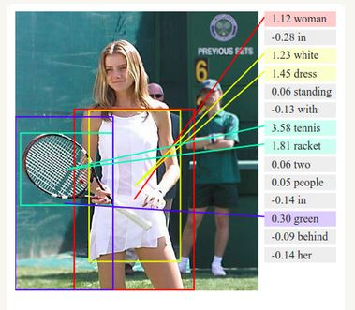
Deep Learning
Uses deep networks instead of shallow models with many layers not always fully connected.
Multiple processing layers, composed of multiple linear and non-linear transformations
Learns multiple levels of representation that correspond to different levels of abstraction; the levels from a hierarchy of concepts

Slide 6
Fooling a Deep Learning System
Are those systems safe?
Wide spread use of computer vision systems can be a threat if algorithms can be “fooled”
Deep Learning techniques are still a black box and generalization is not fully understood
Methods developed range from black box attacks to ones that require understanding of underlying algorithm structure.
Image and Speech recognition being used as “identification” methods in lots of fields

Slide 7
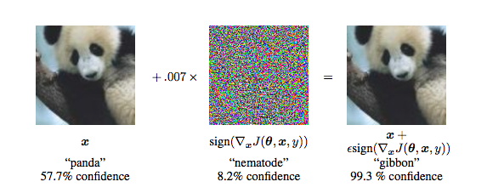
Adversarial Examples
What is an Adversarial?
Small Perturbations to images, usually not recognizable by humans, that completely changes the output label on a classification task
Methods rely on transfer learning
Uses gradient information from the targeted system to optimize pixel perturbation within images

Slide 8
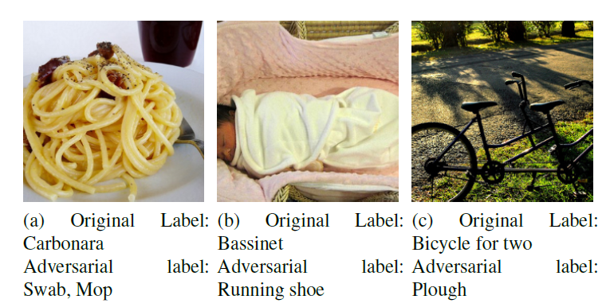
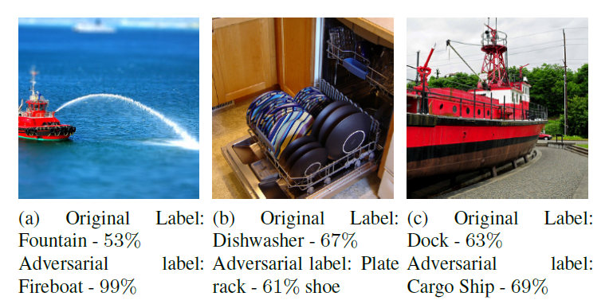
Adversarial Categorization
Adversarial image creating can be split in four different categories
True Adversarial: Classified correctly at test time but on perturbing have been given a completely unrelated class label
Re-Focused Adversarial: A good percentage of images have completely unrelated labels, similar to above. But on looking closely at the image, one can notice the original image has a significant presence

Slide 9
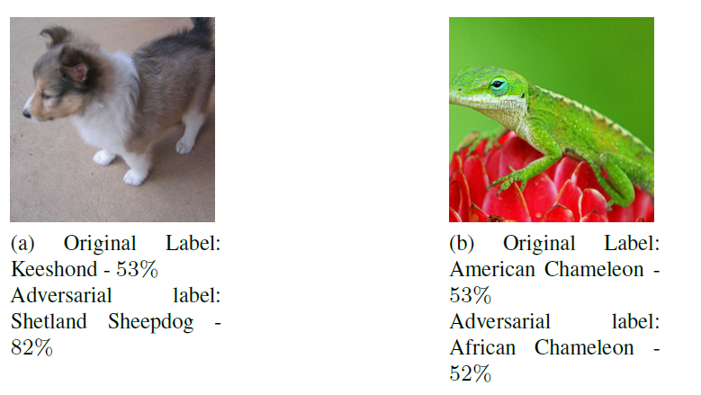
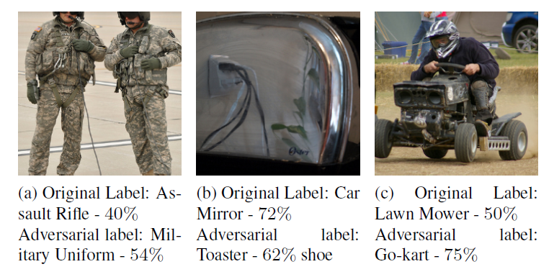
Adversarial Categorization
Adversarial image creating can be split in four different categories
Conaturally Adversarial: Labels having nuanced synsets, like dog and cat. Perturbed images of such labels mostly stay within the same family, genus or species.
Benign Adversarial: Sometimes wrongly label the top prediction of an image, more likely with a low probability. The adversarial example though, is classified correctly with relatively high confidence.

Slide 10
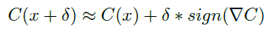
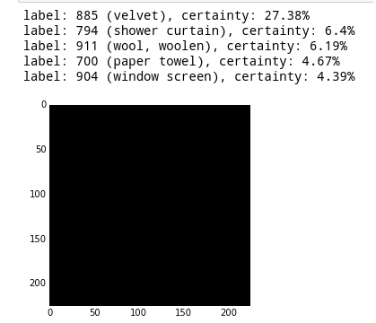
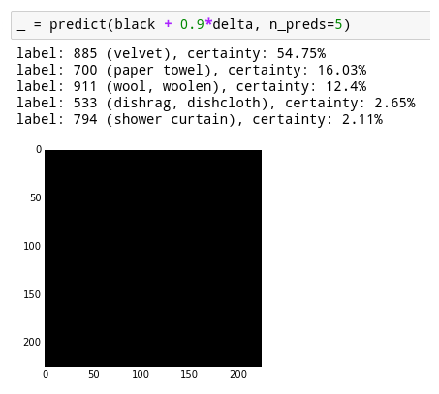
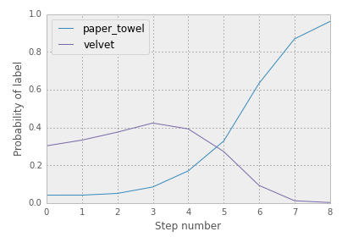
Fast Gradient Sign Method
Adding noise that emphasizes the pixels in the image with the highest importance, so the resulting perturbation can likely lead to a misclassified result.
Maximizing the direction of the gradient calculation by multiplying each pixel of the image by the sign of the gradient vector of the desired image used as a perturbation example.

Slide 11
Problems: Likelihood of Adversarials
Among all 4 categories (Re-Focused, Conaturally, True and Benign) which one would more likely output a wrong label when perturbed?
Are there any intrinsic image characteristics that make them more susceptible to gradient perturbation ?
Does the perturbations have a specific region for each category that they will always try to exploit?

Slide 12
Contributions
Turning network gradient exploitation into knowledge about how these complex and non-linear networks generalize.
Understanding image characteristics that make networks to give right/wrong outputs within classifications tasks.
Use adversarial example crafting as a resource for creating better regularization methods and, therefore, more robust deep learning algorithms.

Slide 13
Results - Fast Gradient Method
XYZ Total Images
WYK Images for Each Category
Steps size for the fast gradient method: 0.1234
Image Type | Top 5 – Error Rate | Top 1 – Error Rate
True Adversarial
Conaturally Adversarial
Re-Focused Adversarial
Benign Adversarial

Slide 14
Results – Iterative Fast Gradient Sign
XYZ Total Images
WYK Images for Each Category
Steps size for the fast gradient method: 0.1234
Image Type | Top 5 – Error Rate | Top 1 – Error Rate
True Adversarial
Conaturally Adversarial
Re-Focused Adversarial
Benign Adversarial

Slide 15
Conclusions and Future Work

